Slide 1

Software Test Automation Group (STAG)
Galen Framework for Visual Automation Testing
By Matthew Chan

Slide 2
Agenda
Galen Framework
Questions
Speak Out

Slide 3
Galen Framework
An open source test framework to test the look and feel of your responsive web-app.
Utilizes Selenium for browser manipulation.
Supports Selenium GRID and cloud execution allowing you to run your tests across multiple devices.
Highly rich and customizable syntax for visual testing.
Comprehensive and pretty HTML reports.
Supports Java and JavaScript

Slide 4
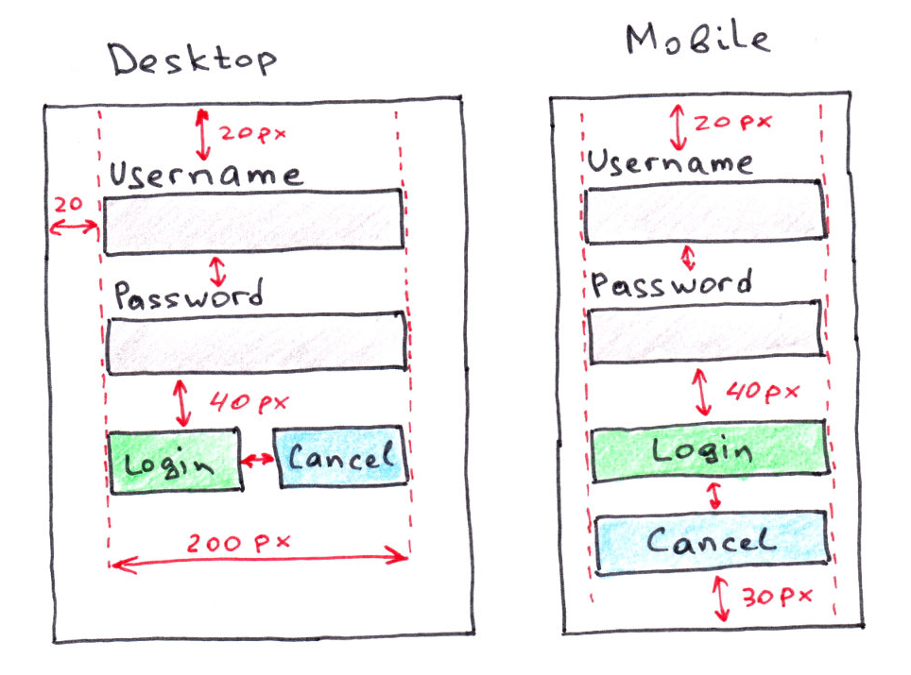
Website look and feel

Slide 5
Getting Started
Install Java 1.8 +
Linux Installation:
Via NPM: sudo npm install –g galenframework-cli
Manual download: sudo ./install.sh
http://galenframework.com/download/
Windows Installation:
Download Galen Framework binary
Add galen.bat to System PATH variable
Comprehensive walkthrough:
http://mindengine.net/post/2014-01-08-configuring-galen-framework-for-windows/

Slide 6
Configuration
Project configuration
Navigate to your project directory
Type: galen config, this will create a galen.config file in your project directory
Global configuration
Type: galen config –global, this will be your global config that will be applicable to all your projects.
This is recommended for basic configuration such as Firefox/Chrome/Phantomjs driver paths.

Slide 7
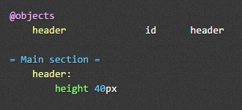

Your First Basic Galen Test
Create Galen Spec file
Set galen.config

Slide 8

Galen Test Suite
Galen test suite defined with .test file extension
Basic format
Test name
Test URL + resolution
Galen action + spec file + tags
Supports variables
Page actions via JS injection
Supports browser factory and Selenium GRID
Parameterization
Test groups

Slide 9
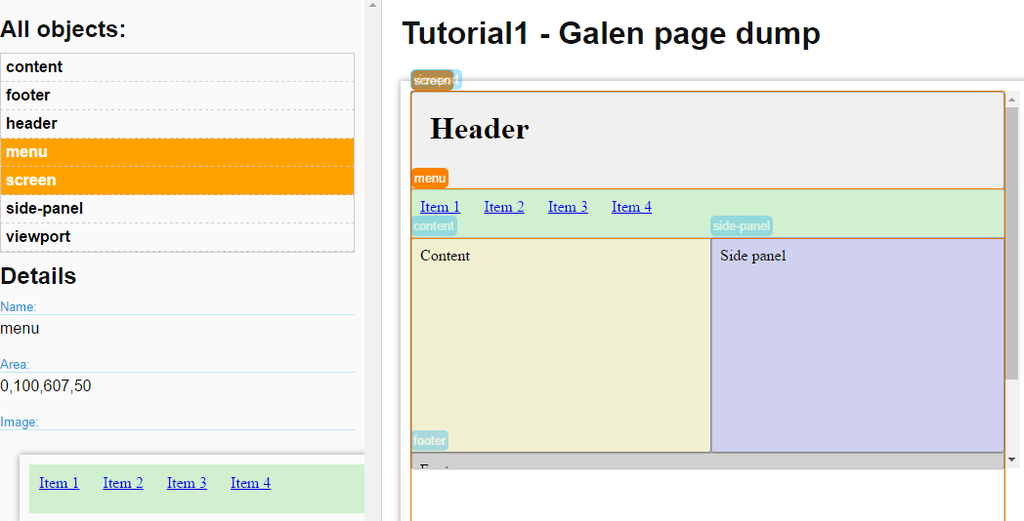

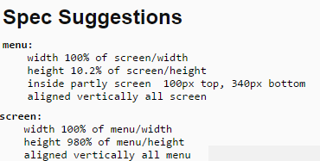
Galen Dump Feature
Create a page dump, stores information about all test objects with image samples and suggested syntax for test specs.

Slide 10
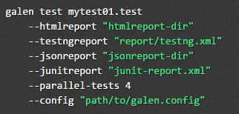
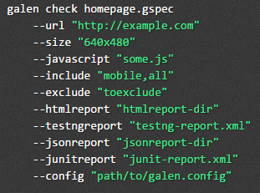
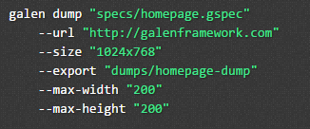
Galen CLI Options
Run single page Galen test
Run Galen test suite
Run Galen dump

Slide 11
Galen Language Syntax
Comprehensive language syntax used in spec files
Refer to
http://galenframework.com/docs/reference-galen-spec-language-guide

Slide 12
Galen with Java
Galen + Java + Maven + TestNG + IDE support
IntelliJ IDEA recommended, Spec plugin support
Create maven project – add Galen library dependency
Test classes extends GalenTestNgTestBase
Use selenium for browser and page element manipulation
Call GalenJavaTestBase class methods from the Galen API for verification
Initialize Galen HTML reporter manually or via a listener.
Execute using Maven – supports parallel execution

Slide 13
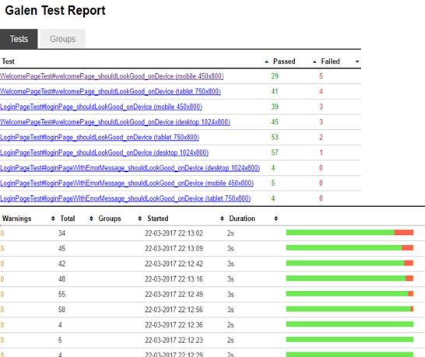
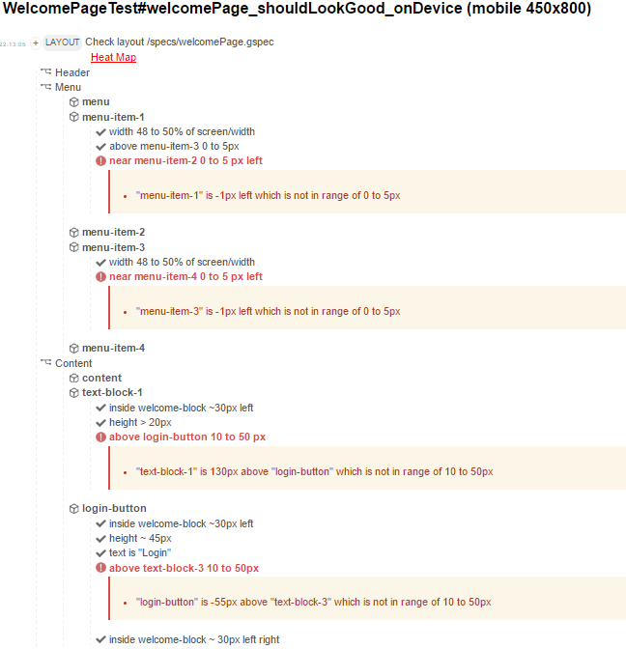
Galen HTML Report

Slide 14

Questions?

